Slide 1
DrugBank Browser
Specifications Document

Slide 2
The Goal
As per its name, the main purpose of the DrugBank Browser is to enable users to conveniently browse through the data. To that end, users will be provided with facilities that enable selecting and filtering of the data via intuitive and easy-to-use UI components.
Furthermore, the DrugBank browser shall provide the functionality of generating visualizations (e.g. bar charts, box plots, etc.) based on the selected/filtered data.
Finally, the DrugBank browser will allow users to export the above-mentioned data and visualizations

Slide 3
Notes Before Moving On
All specifications in this document are intended as a first draft of the project
Specifications in BLUE are intended for future versions.
Side Note:
Practitioners in drug discovery are quite familiar with MS Excel. Many of the intended features of the DrugBank Browser have similar counterparts in Excel. Since humans are creatures of habit, if they find the features too same-same, they will stick to what they already know (which, of course, is not what we want). This is just something to bear in mind.

Slide 4
The User Interface
Radial Tree
The first thing the user sees is a radial tree (see next slide for an example)
This radial tree is a reflection of the XML structure of the DrugBank database
1st impression: The number of nodes in the radial tree should probably be equal to the number of data frames returned by the function, dbparser::parse_drug_all()
i.e. 72 data frames
As any other feature in this document, this point is open for discussion.

Slide 5
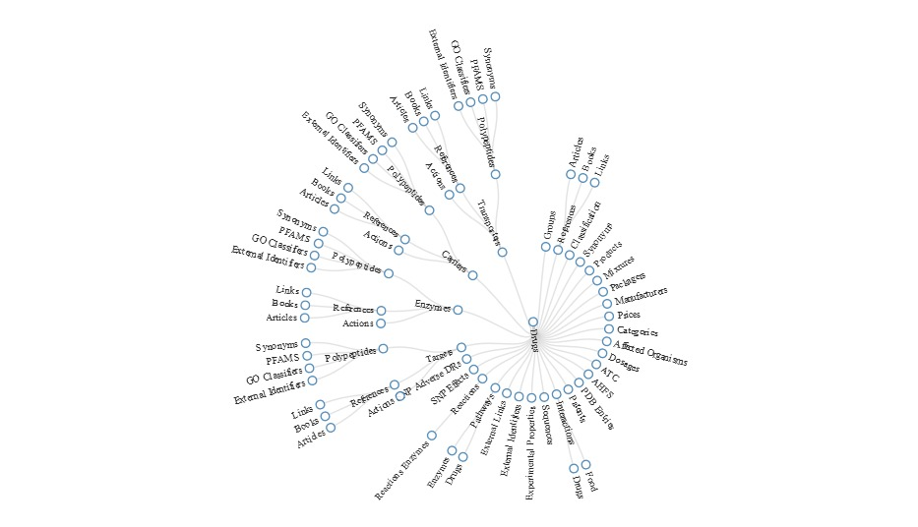

Slide 6
The User Interface
Radial Tree
When the radial tree is loaded, the “Drugs” node is selected (i.e. highlighted) by default, and a table below it is displayed showing its corresponding data frame info (ignore “_counts” columns).
After that, whenever a node is selected:
If it is an already selected node, do nothing.
Otherwise, ask user to confirm selection:
No → do nothing
Yes → refresh table
Advanced → selection confirmation may be skipped if no operations (e.g. filtering) have been performed yet on the table to be refreshed.

Slide 7
The User Interface
Table
At first, the table will hold the entire set of data pertaining to the node selected in the above radial tree.
Given this data, the user has the following options:

Slide 8
The User Interface
Table
At first, the table will hold the entire set of data pertaining to the node selected in the above radial tree.
Given this data, the user has the following options:
Add/Remove Fields
The user will be able to add/remove fields …
Fields of the selected node
Fields of the selected node’s direct parent node
Fields that are made up on the fly (i.e. using dplyr::mutate())
By the way, this has analogues in MS Excel
[cell] D4=B4+C4 OR [cell] E21=SUM(E2:E20)

Slide 9
The User Interface
Table
At first, the table will hold the entire set of data pertaining to the node selected in the above radial tree.
Given this data, the user has the following options:
Filter
Based on fields currently in the displayed table …
Filter non-numerical columns
Regular expressions (like in MOSART)
Select from dropdown/list (allow multiple selection)
Filter numerical columns
== , != , > , >= , < , <=
Any NA’s in the data?
Just keep in mind!

Slide 10
The User Interface
Table
At first, the table will hold the entire set of data pertaining to the node selected in the above radial tree.
Given this data, the user has the following options:
Describe
Provides a (statistical) summary of the data displayed in the table
A good visual example can be found in the following link (slide 16):
https://www.slideshare.net/jmgf2009/r-and-mind-mapping-automation
The displayed table is left intact and the “description” table is to open in a new tab

Slide 11
The User Interface
Table
At first, the table will hold the entire set of data pertaining to the node selected in the above radial tree.
Given this data, the user has the following options:
Export
Exports the displayed table to a CSV file that the user may download
Other options:
Export to a tab-delimited file
Export to an online Google sheet (will assume the user is already logged into their Google account on their web browser)

Slide 12
The User Interface
Table
At first, the table will hold the entire set of data pertaining to the node selected in the above radial tree.
Given this data, the user has the following options:
Aggregate
The user selects the field(s) to aggregate by
Next, the user will be asked if they want to add a column by applying an aggregate function on one of the remaining fields
If no field selected → then show unique values of selected fields
Remaining fields (that were not selected) will be discarded
Examples of aggregate functions: count, sum, mean, std, median, etc.

Slide 13
The User Interface
Table
At first, the table will hold the entire set of data pertaining to the node selected in the above radial tree.
Given this data, the user has the following options:
Show Script (and Save?)
Shows the user (in a separate tab) the steps taken to generate the table currently displayed.
The user may then choose to save the script to use later
Advanced: the user may later modify the script (manually) to change some of its details. For example, the user may want to apply their (very complex) script to some other data but without having to go through all the steps again.

Slide 14
The User Interface
Table
At first, the table will hold the entire set of data pertaining to the node selected in the above radial tree.
Given this data, the user has the following options:
Visualize
The user selects the kind of visualization they want
The user then selects the table columns to be involved in the visualization (as well as any visual elements like title, axes labels, etc.)
Hint: it will be very similar to how visualizations are done in Excel
Example visualizations: bar charts, box plots, pie charts, line graphs
Visualization area will be directly below the table

Slide 15
The User Interface
Table
At first, the table will hold the entire set of data pertaining to the node selected in the above radial tree.
Given this data, the user has the following options:
Visualize (Continued)
Near the visualization area there will be two buttons:
Show in new tab (should we add a similar button for the table?)
Export (image file, .png, .jpg, vector graphics file, .eps, .svg)
All stylistic graphics choices (colors, opacity, line width, etc.) will be fixed in the first version.
Later, user (graphics) preferences will be saved as part of their profile.

Slide 16
Other Details
If the user accidentally closes their web browser, when they reopen the DrugBank Browser, they should find that their work was not lost and that it is exactly how they left it.
The displayed table to have sorting capabilities
Advanced: sort by multiple fields. Hint: see what happens when you give two column names to dplyr::arrange()

